Slide 1
Launch and Configure a WordPress Instance with Amazon Lightsail

Slide 2
Introduction & Key Features
Introduction
Amazon Lightsail is an accessible entry point to AWS (Amazon Web Services).
It simplifies cloud infrastructure setup and management.
Ideal for beginners and small-scale projects.
Key Features
Virtual Servers: Spin up instances with ease.
Storage: Store data securely.
Databases: Set up databases effortlessly.
Networking: Manage network resources.
Cost-Effective: Predictable monthly pricing.

Slide 3

Sign in to lightsail console and create an instance

Slide 4
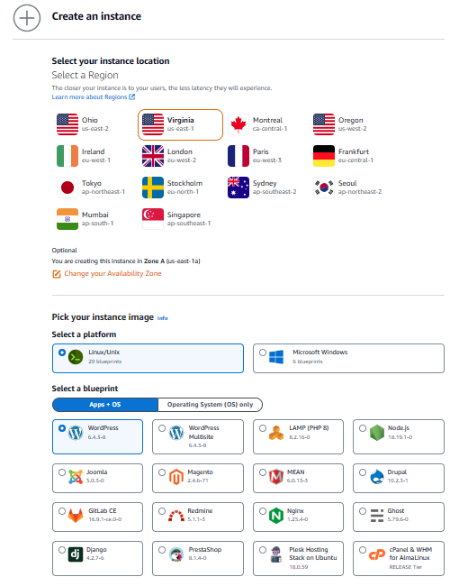
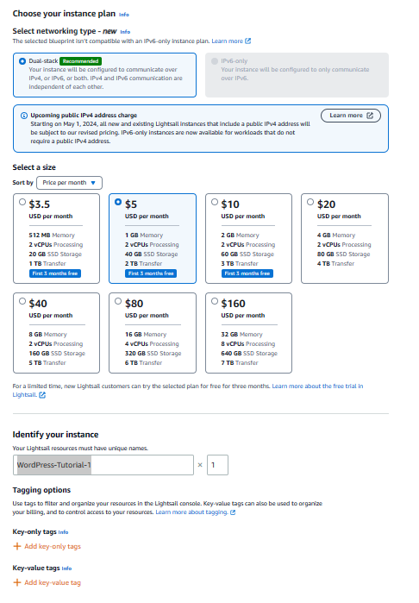
Launch instance
Step 1: Launch Instance
Choose your instance location.
Choose an instance image (e.g., WordPress).
Choose your instance plan.
Identify your instance.
Create instance.

Slide 5
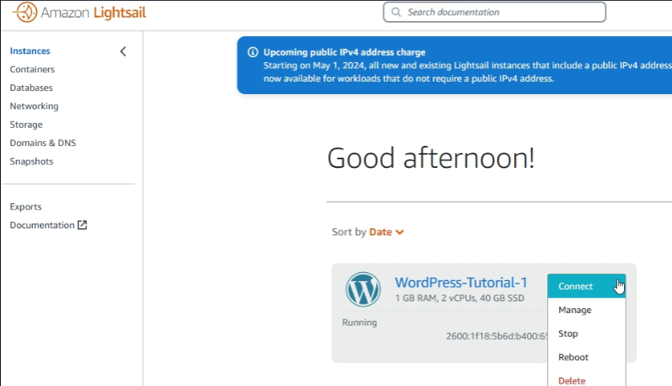
Connect via ssh
Step 2: Connect to your instance via SSH and get the password for your WordPress website
On the Instances tab of the Lightsail home page, choose the SSH quick-connect icon for your WordPress instance.

Slide 6
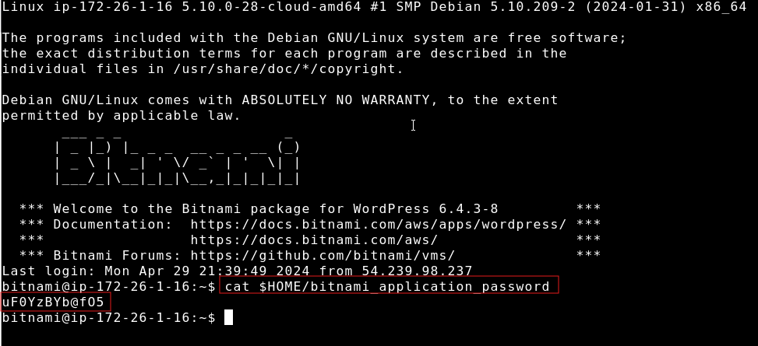
Retrieve default password
Step 3: Type the following command.
cat $HOME/bitnami_application_password and take not of password.

Slide 7
Sign in to the admin dashboard
Step 4: In a browser go to:
http://PublicIpAddress/wp-login.php
*Note: In the address, replace PublicIpAddress with the public IP address of your WordPress instance.

Slide 8
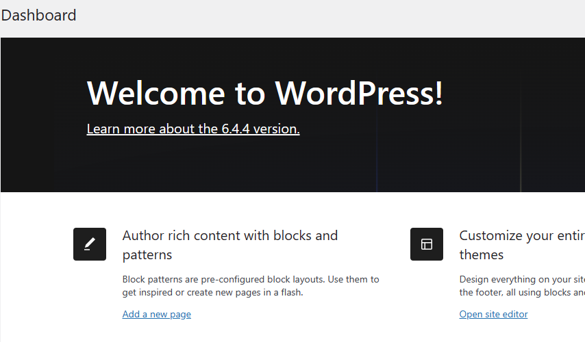
You are now signed in

Slide 9
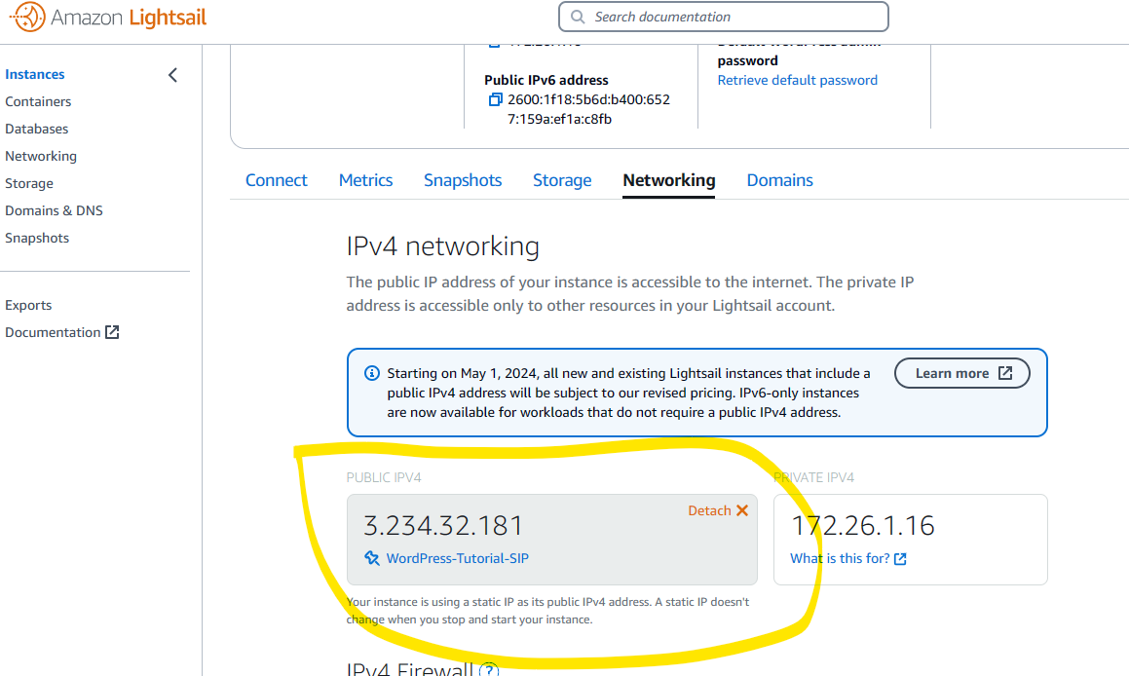
Create a lightsail static ip address & attach it to your wordpress instance
On the instances tab of the LightSail home page choose your running WordPress instance.
Choose the networking tab, then choose create a static IP.

Slide 10
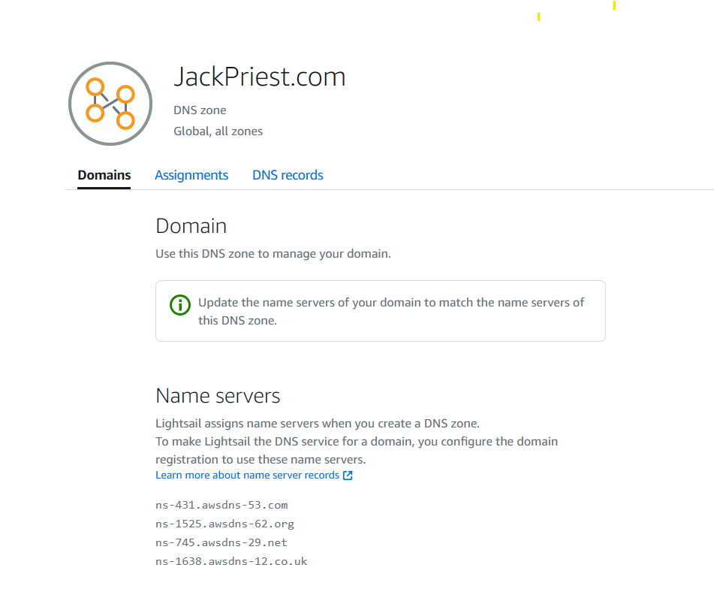
Create a Lightsail DNS zone and map a domain to your WordPress instance
On the Networking tab of the LightSail home page, choose Create DNS zone.
Enter your domain, then choose Create DNS zone.
Make note of the name server address listed on the page.
You add these name server addresses to your domain name’s registrar to transfer management of your domain’s DNS records to LightSail.

Slide 11
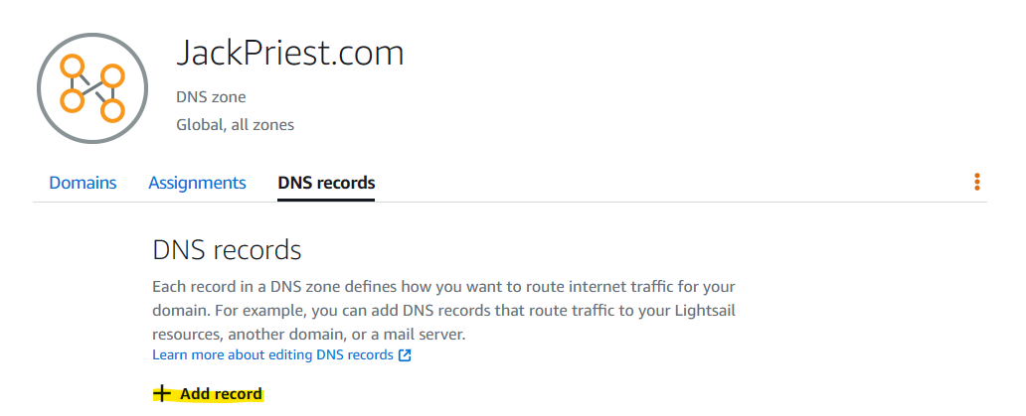
Create a Lightsail DNS zone and map a domain to your WordPress instance
After management of your domain’s DNS records are transferred to LightSail, add an A record to point the apex of your domain to your WordPress instance, as follows:
You add these name server addresses to your domain name’s registrar to transfer management of your domain’s DNS records to LightSail.
In the DNS zone for your domain, choose Add record.

Slide 12
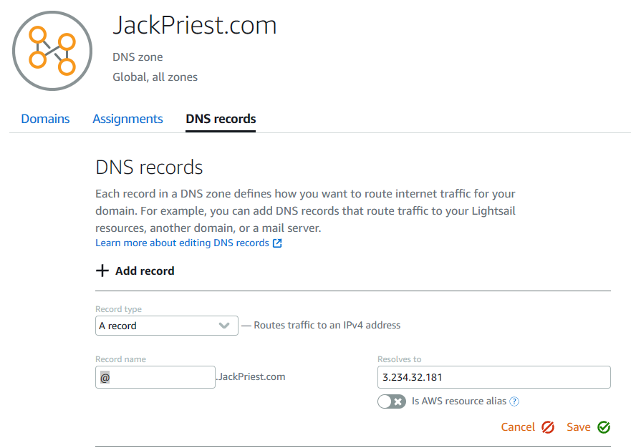
Create a Lightsail DNS zone and map a domain to your WordPress instance
Continue adding the following details to complete pointing the apex of your domain to your WordPress instance:
In the Subdomain box, enter an @ symbol to map the apex of your domain (such as example.com) to your instance. The @ symbol explicitly symbolizes that you’re adding an apex record. It is not added as a subdomain.
In the Resolves to box, choose the static IP that you attached to the WordPress instance in the previous step of this tutorial.
Choose the green save icon.
Allow time for the change to propagate through the internet's DNS before your domain begins routing traffic to your WordPress instance.

Slide 13


Thank you
Allow time for the change to propagate through the internet’s DNS before you start seeing traffic to your site.

